Slide 1

Robotics in Transportation
Fang, Kaiduo
UMID: 66399734

Slide 2
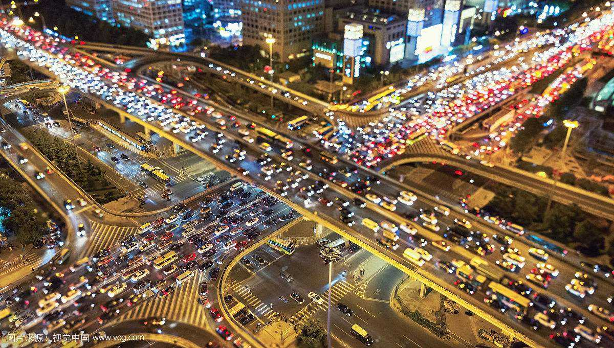
Severe Traffic Jam in Beijing.

Slide 3
Reasons are complex.

Slide 4
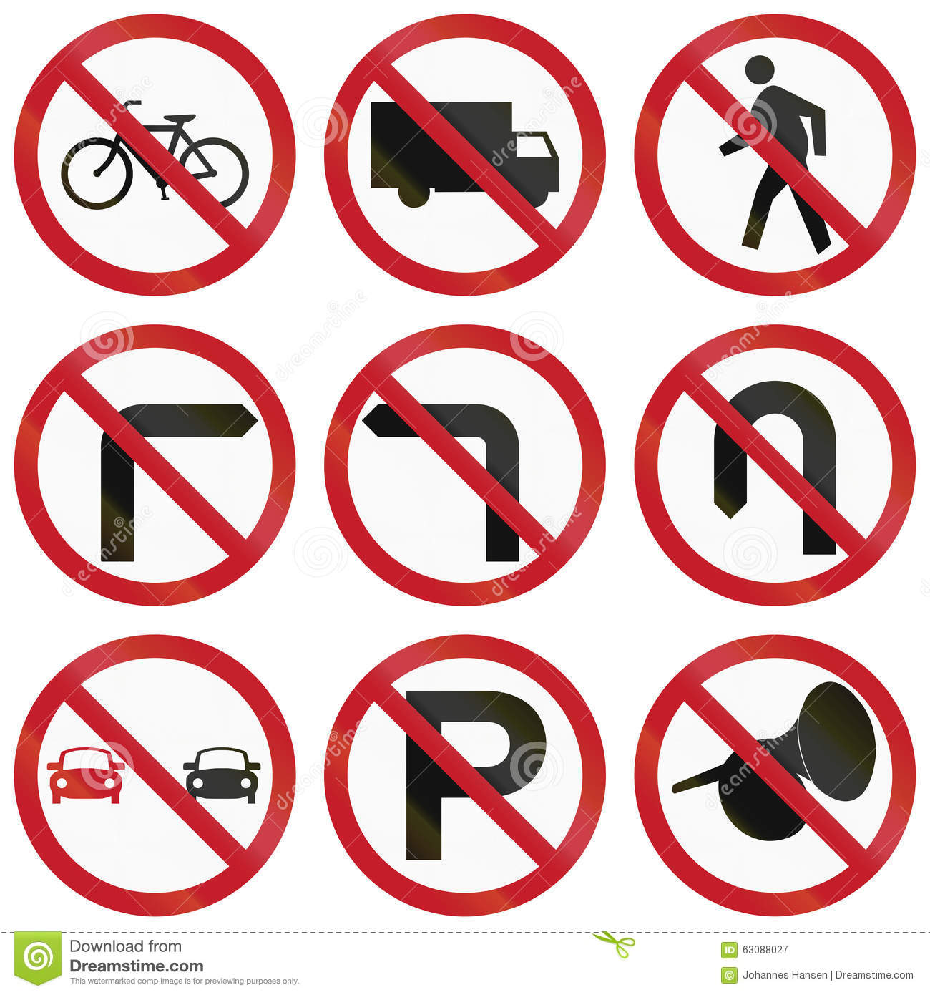
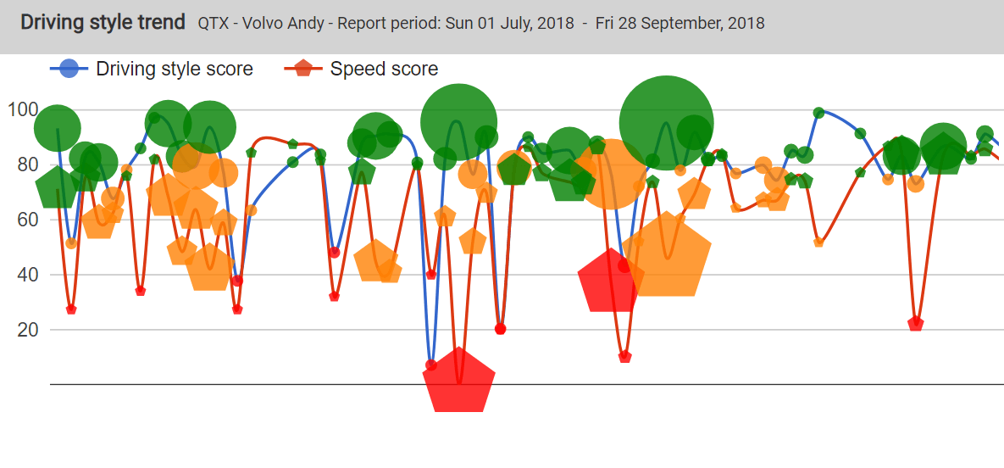
Part of the reasons

Slide 5
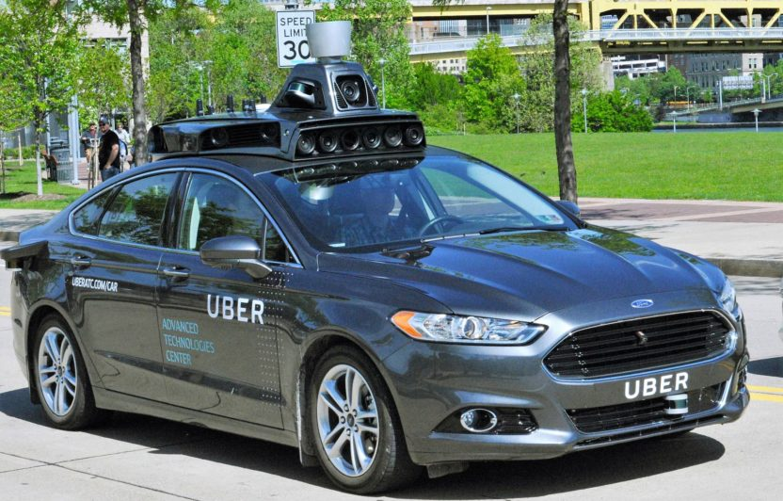
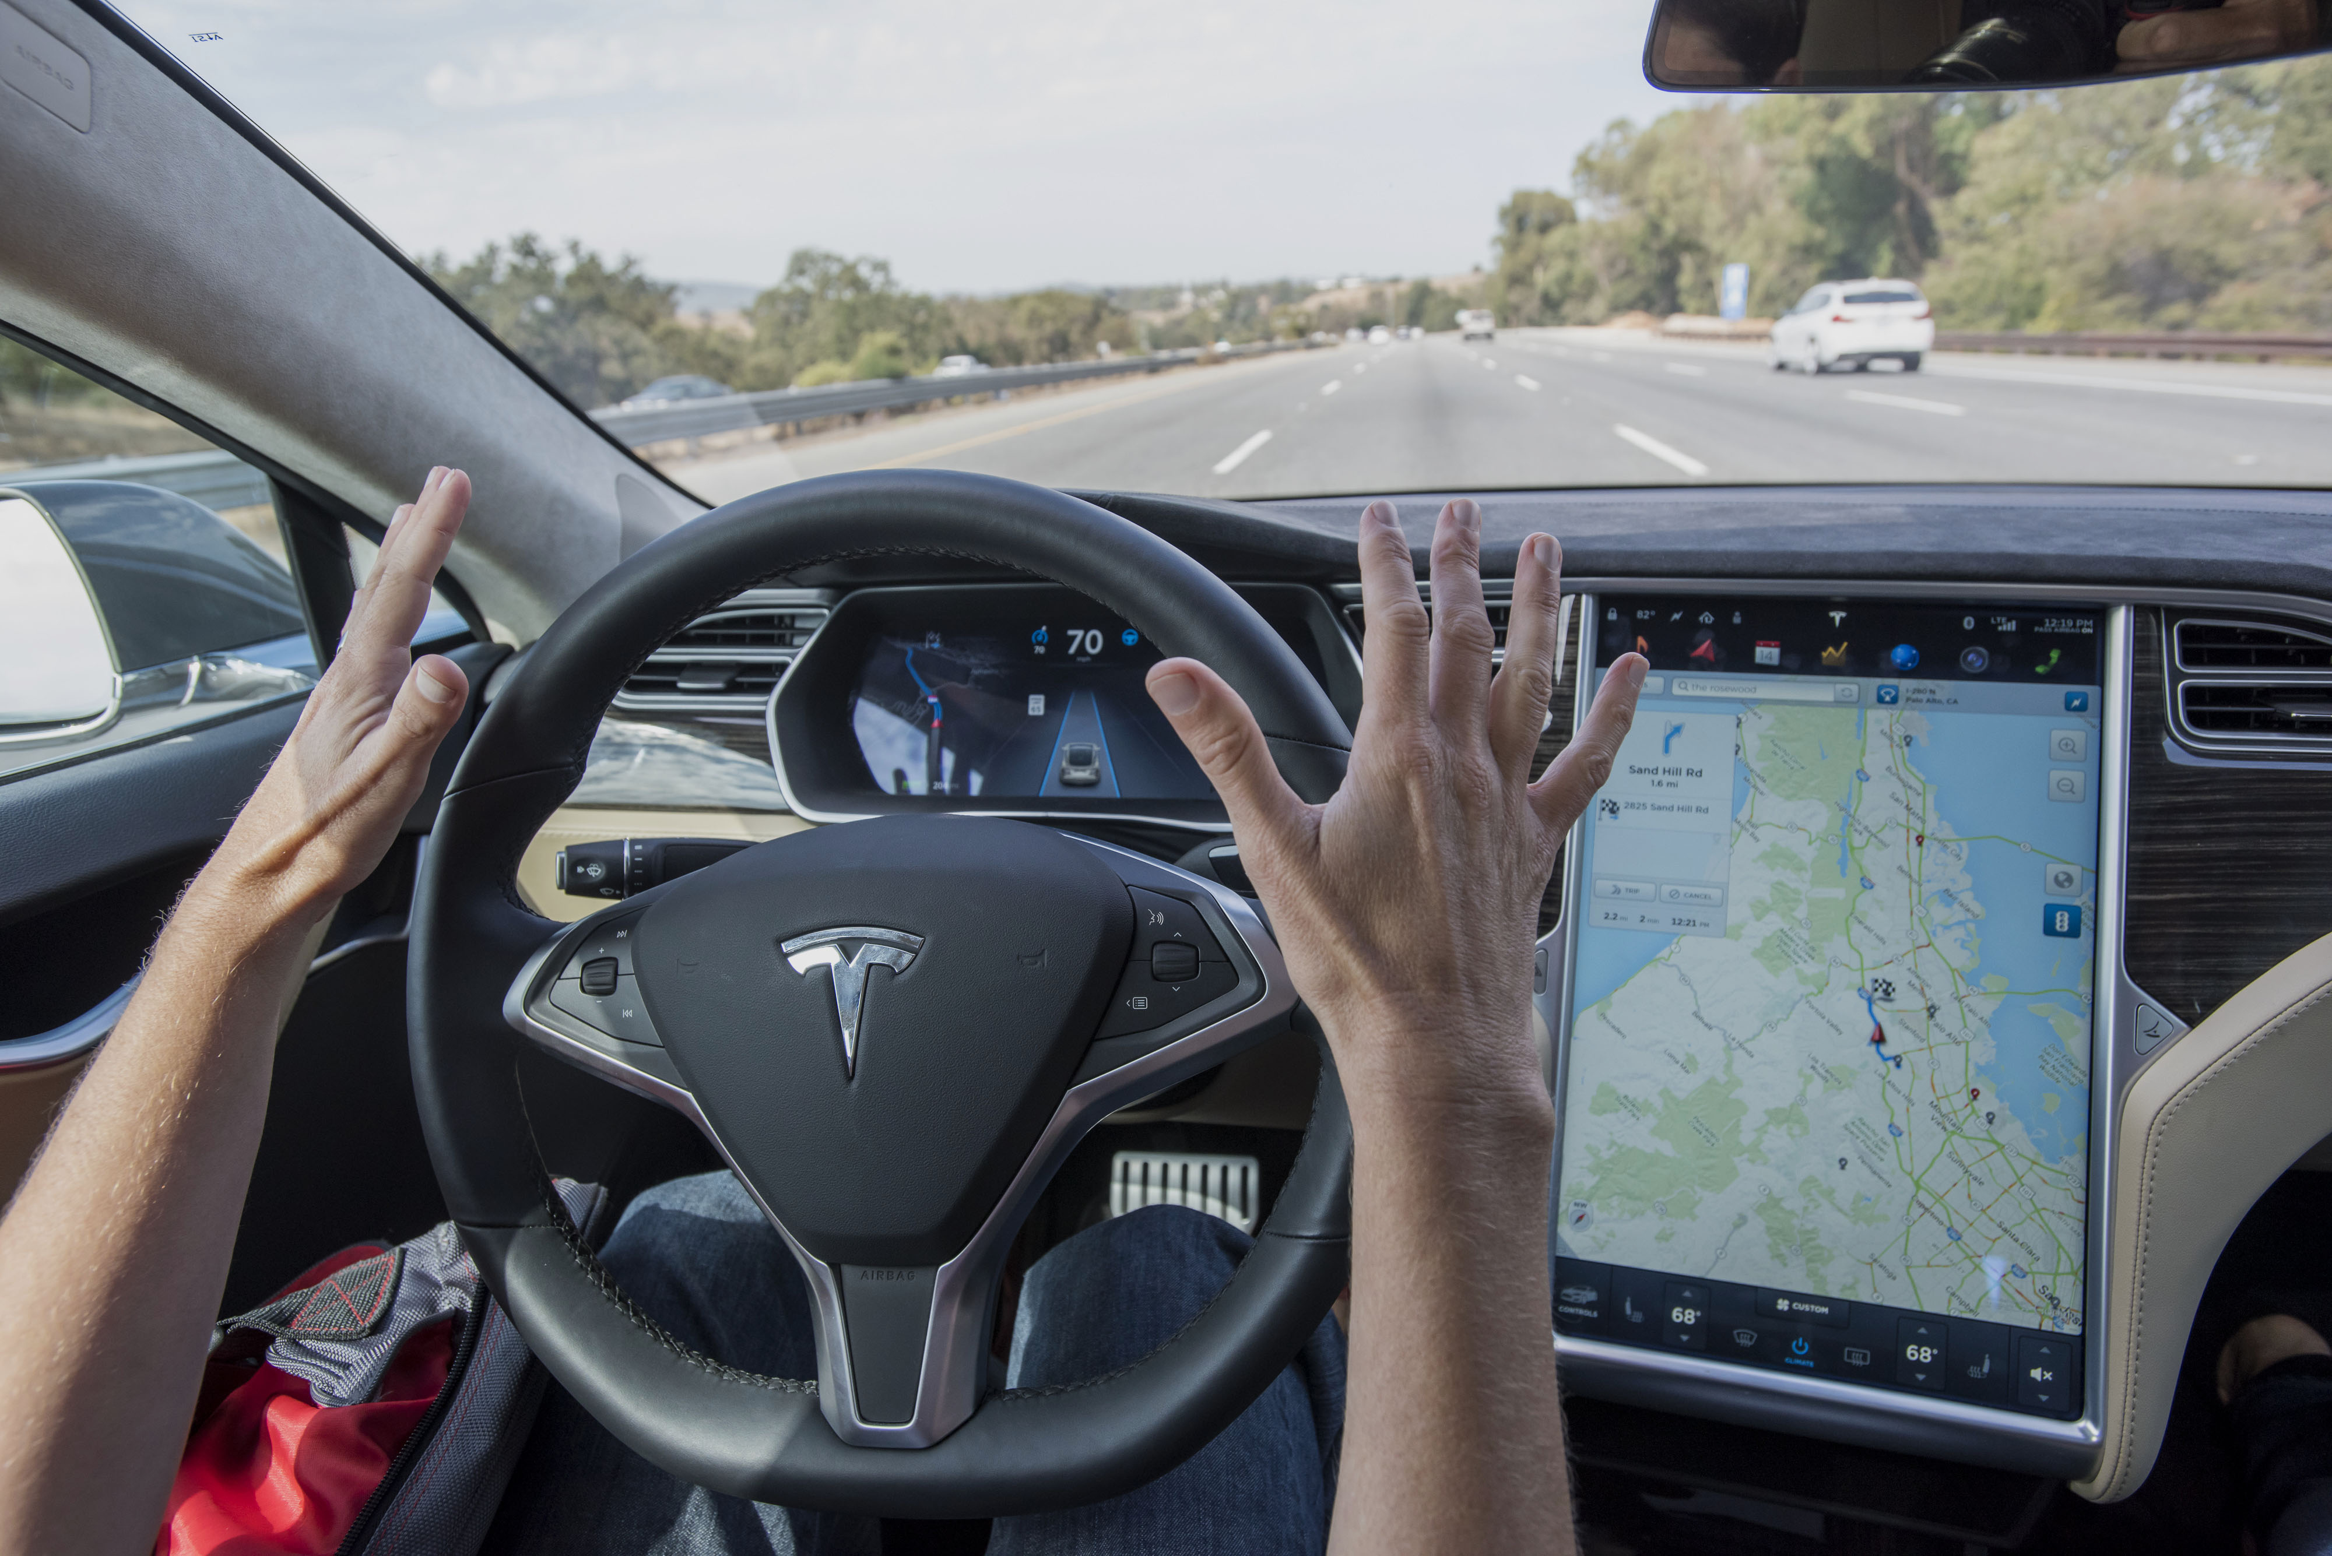
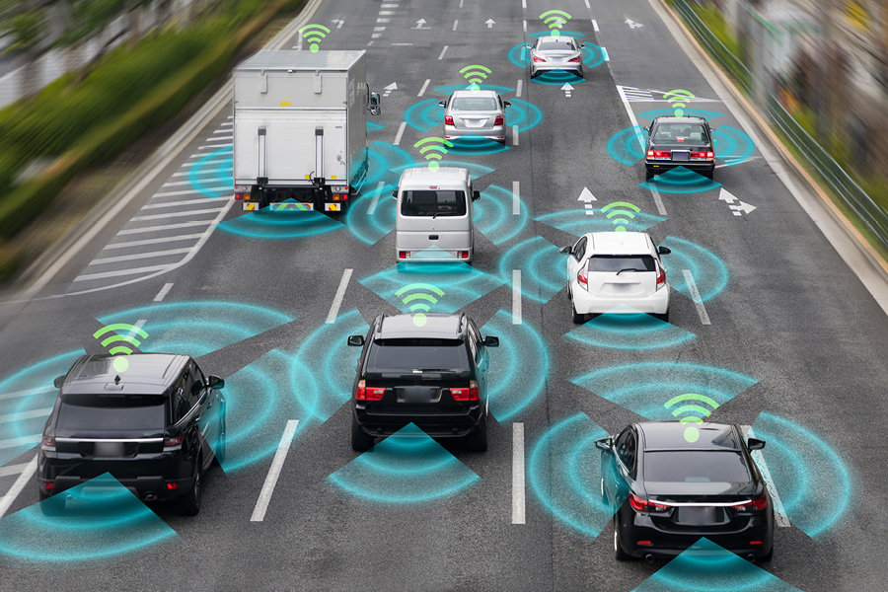
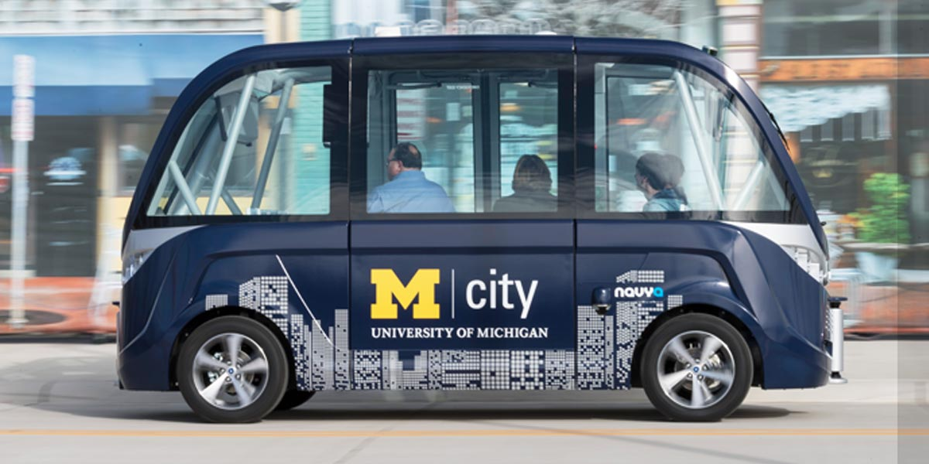
Autonomous Vehicle

Slide 6
Techniques

Slide 7
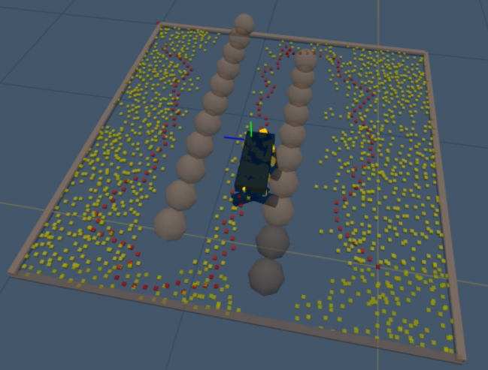
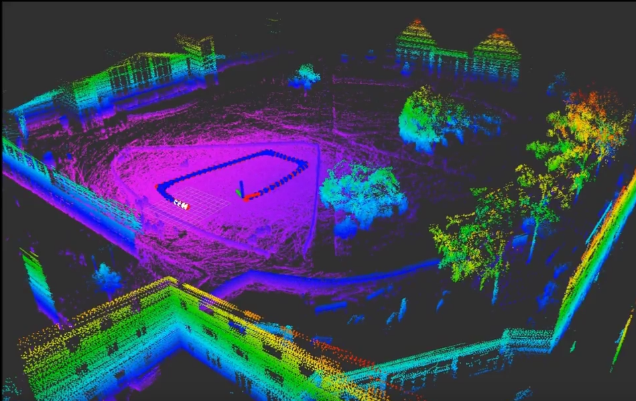
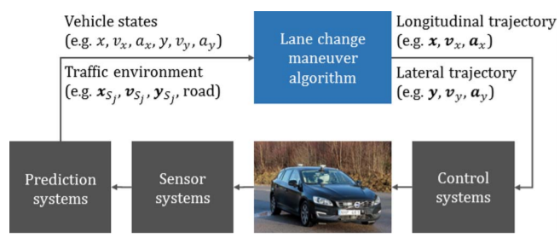
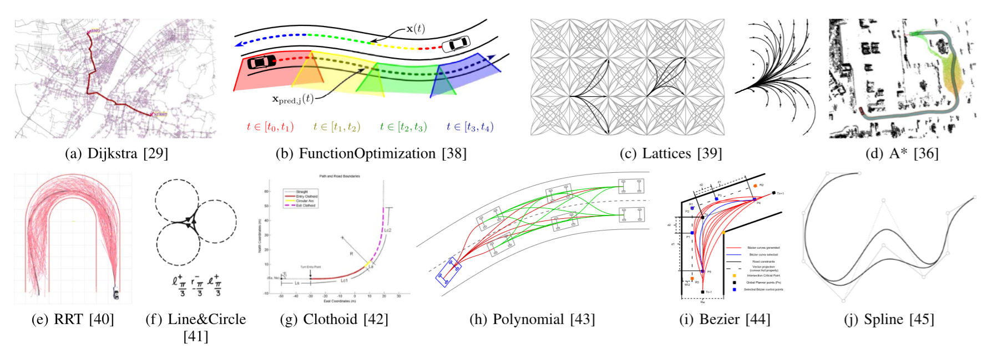
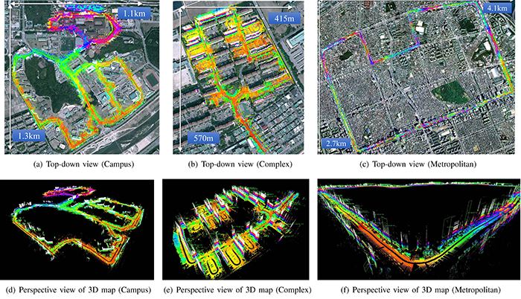
Perception
Planning
Control

Slide 8
A solid investment
The market of Autonomous Driving will be $54 billion in 2019 and keep growing to $550 billion till 2026.
The annual growing rate will be over 30%.
A safer, more efficient and more convenient future.

Slide 9
Thank You!

